Slide 1
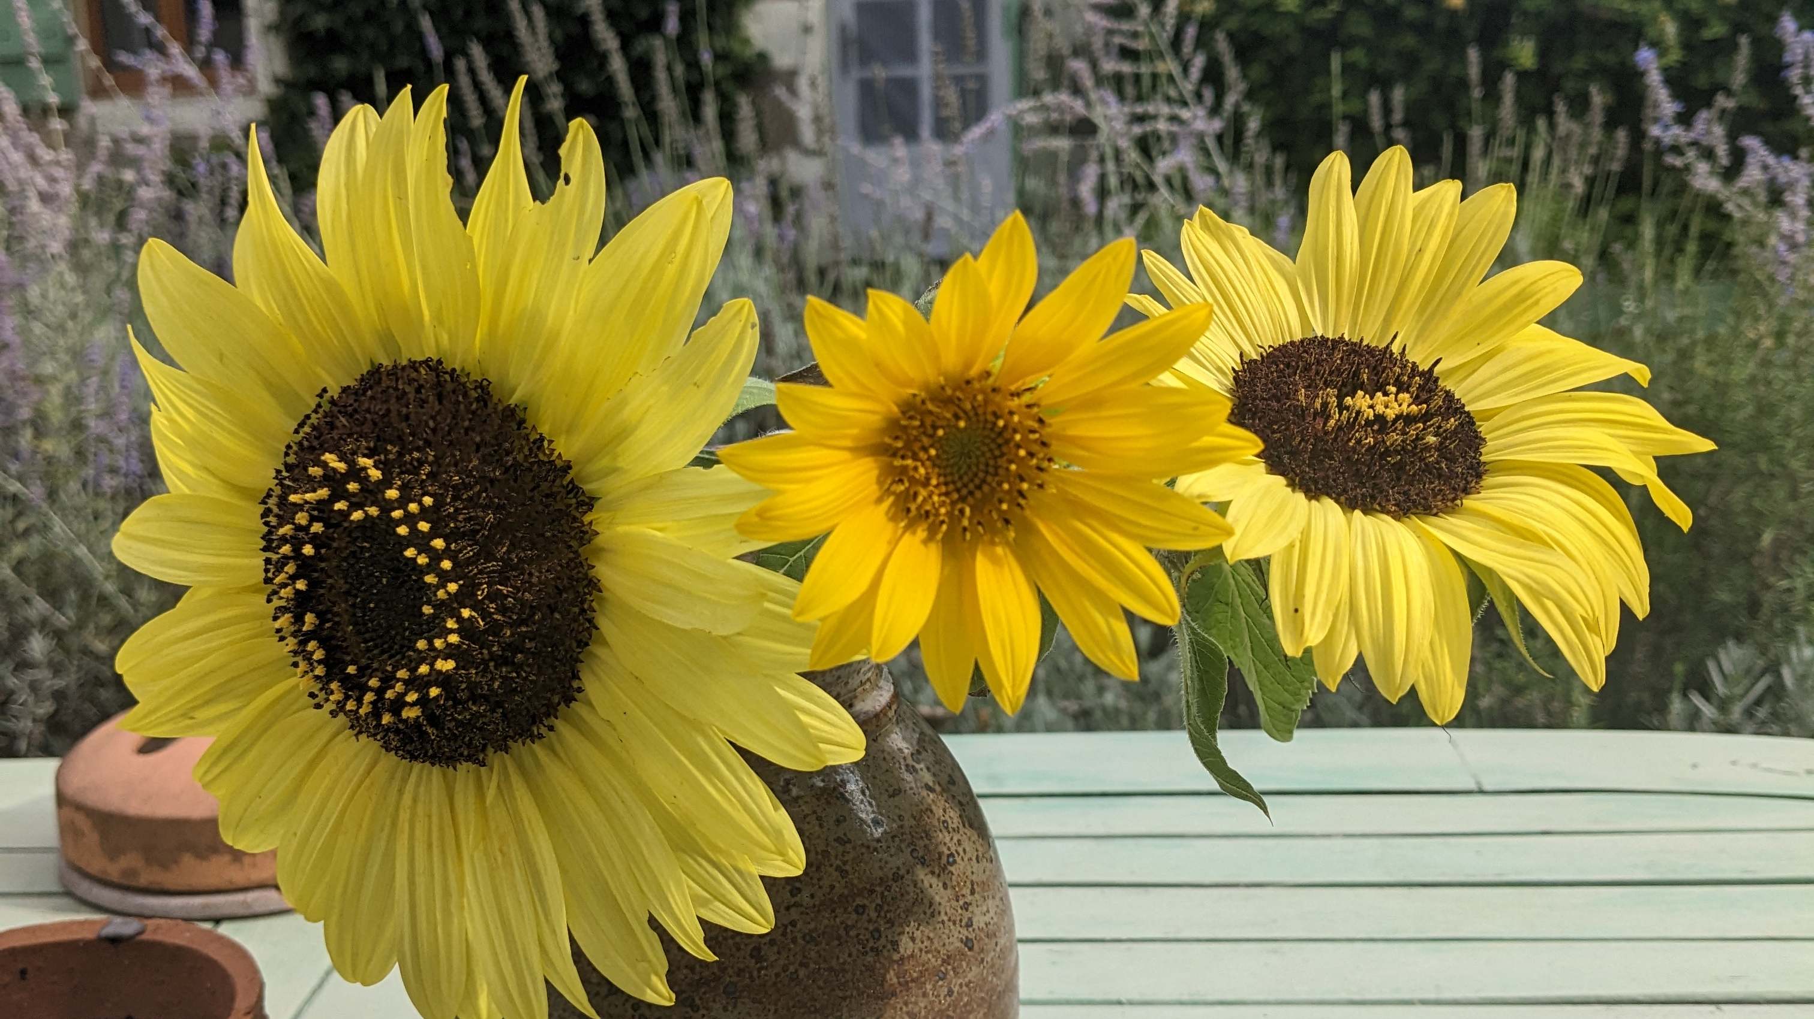
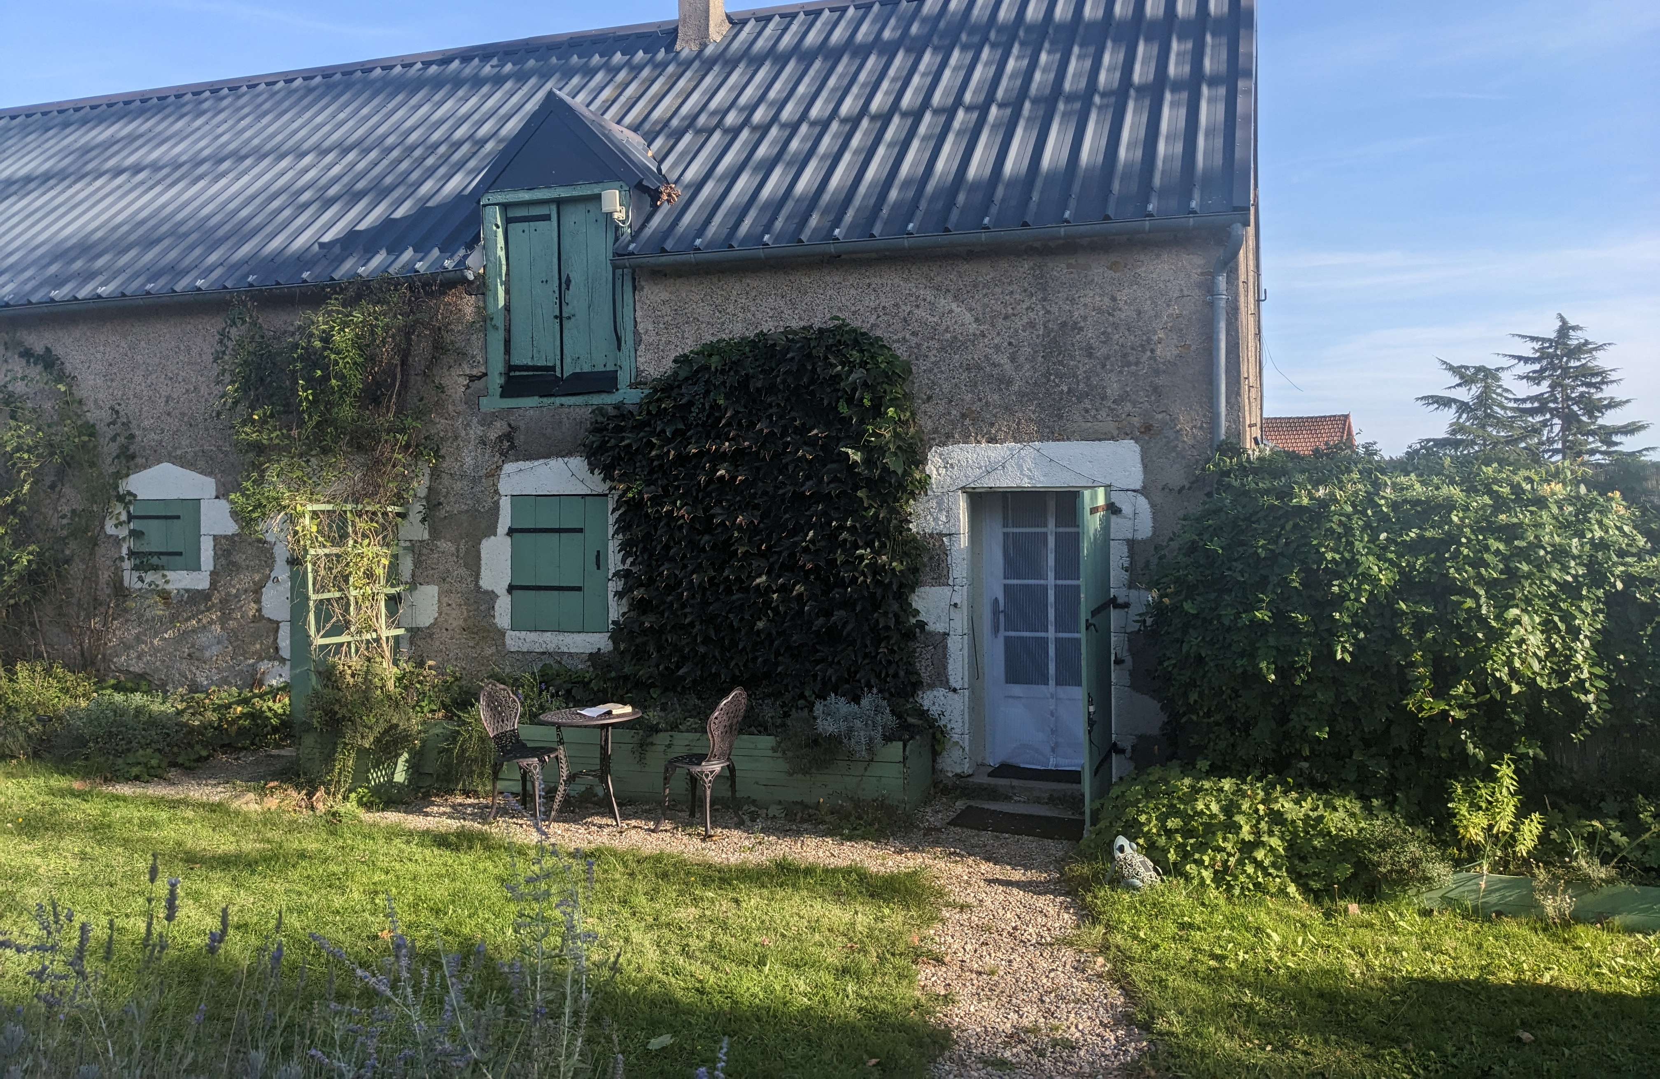
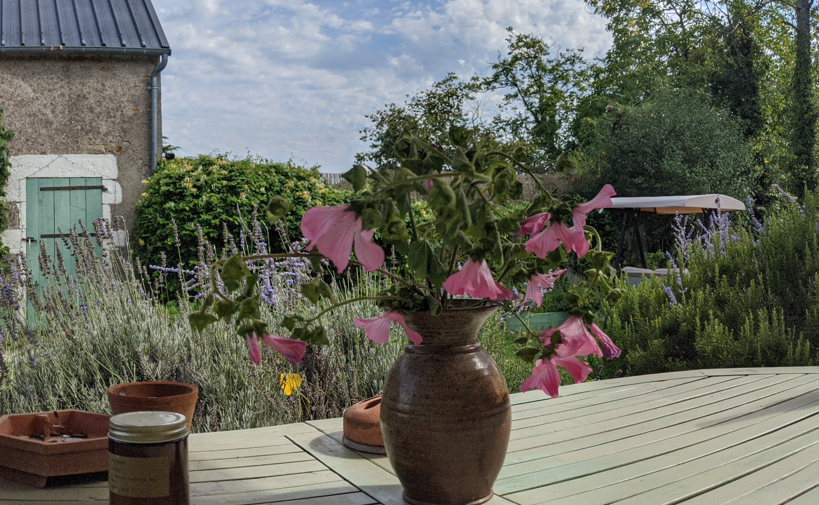
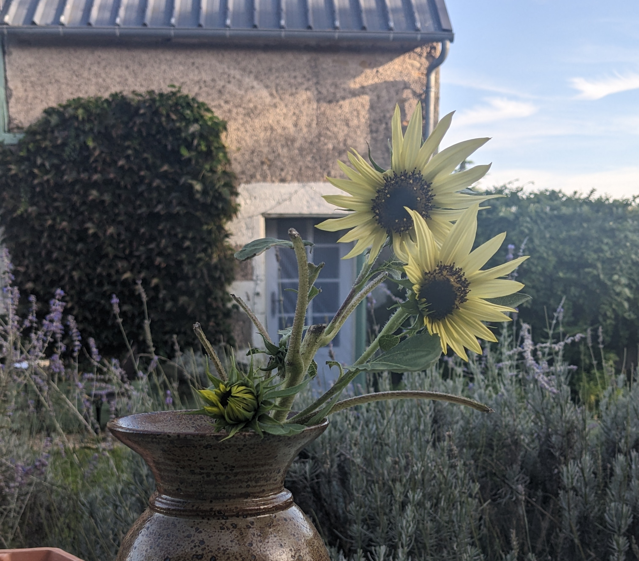
Frugal French Farmhouse
Everyday Doses of Positive Therapy
LIVE Session on 7th April 2024

Slide 2
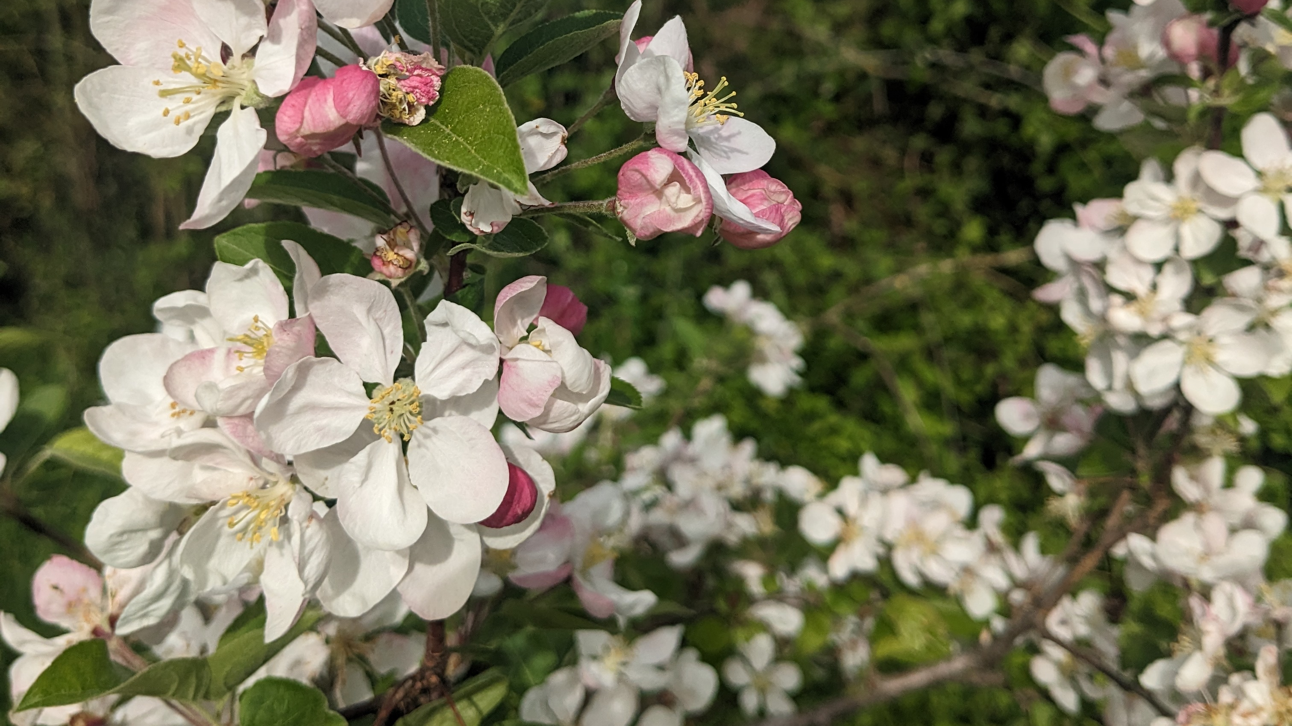
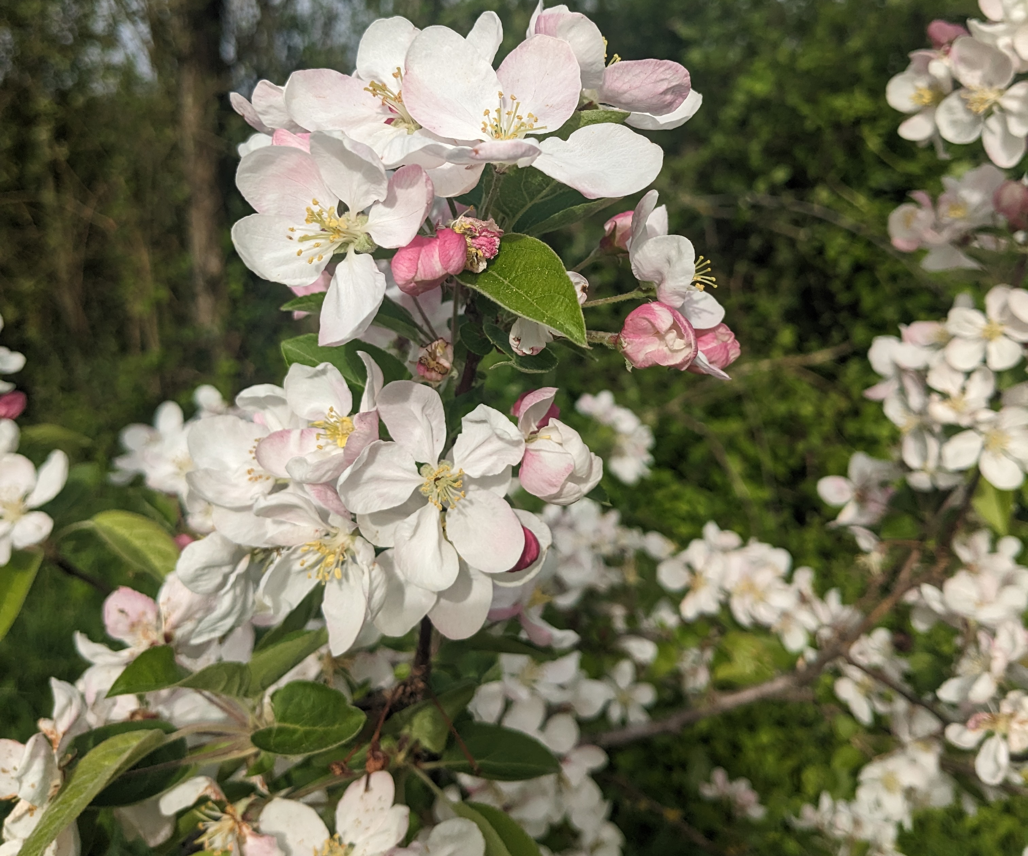
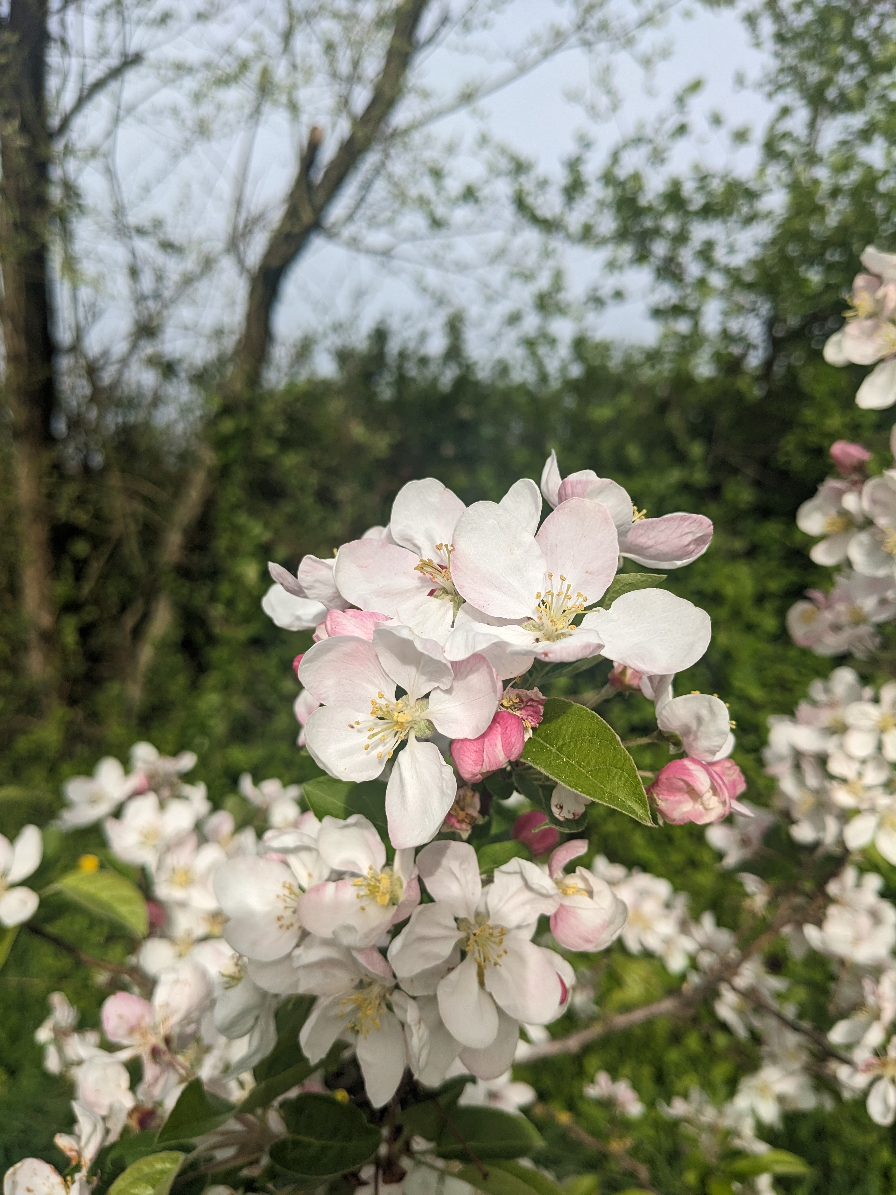
Bonjoir/Bonsoir
Welcome to some time away from a busy day

Slide 3

Any Questions!!
Write in the Comments and we can work through at the end.

Slide 4
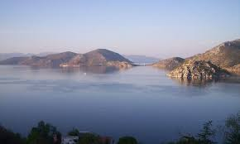
Calming Down
Sensory Strategies for Stressful Days

Slide 5
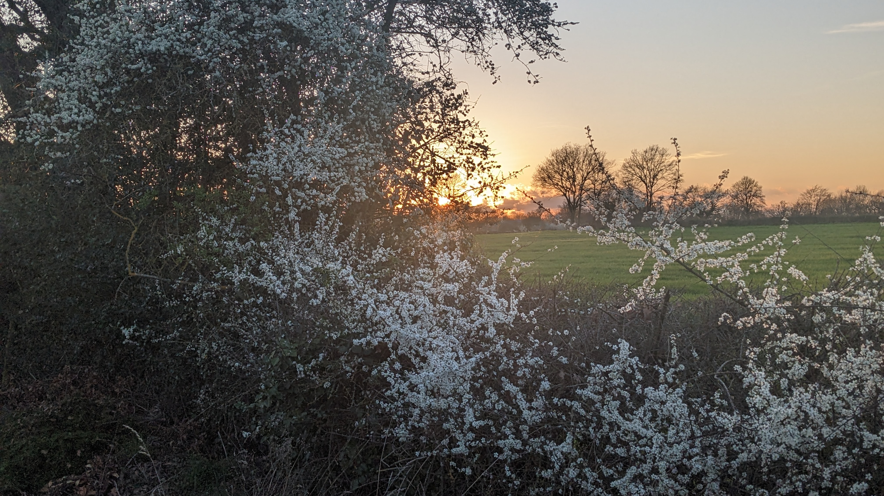
Bring in the Senses
Regulate your reactions and melt away tension.

Slide 6

Looking/Visualizing
Have a photo ready on your phone and look at it closely.
If you have a short video e.g. of a woodland walk, or a stream, then even better.

Slide 7



Something more abstract e.g. a mix of green or turquoise colors can work well.
Images of Sea, Sunset and Trees work well.
And remember you can do a quick search for images on a search engine or on Pinterest. Technology can support at stressful times.

Slide 8
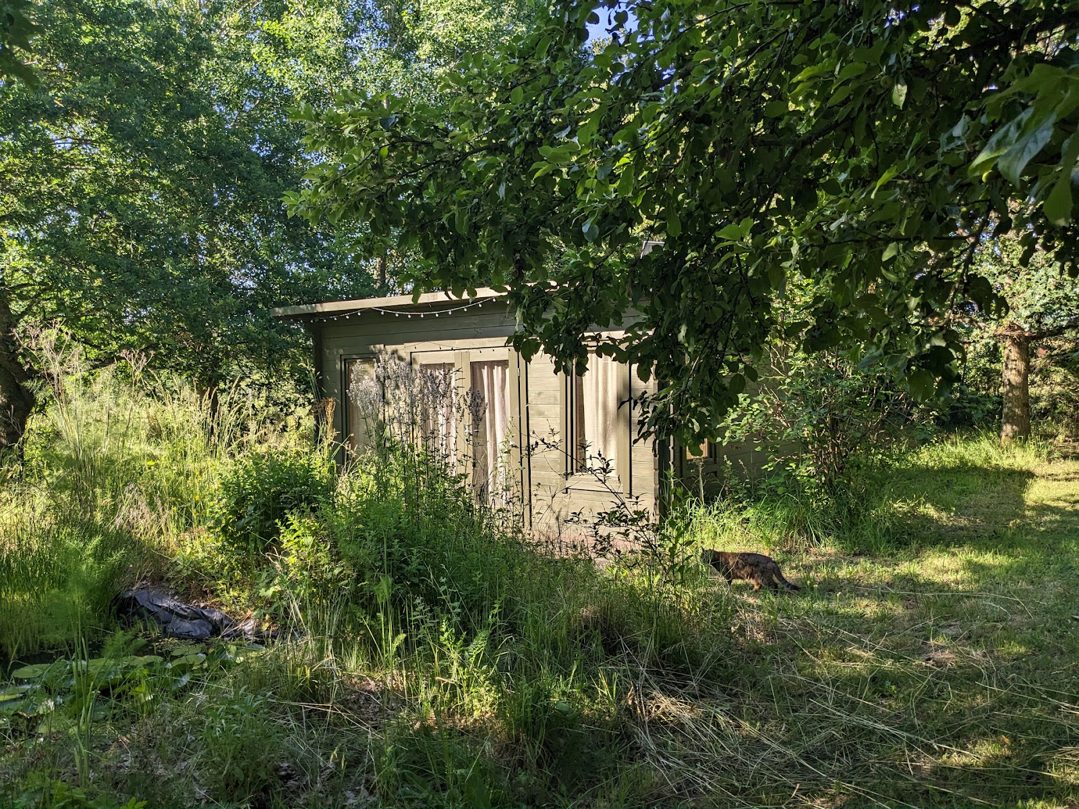
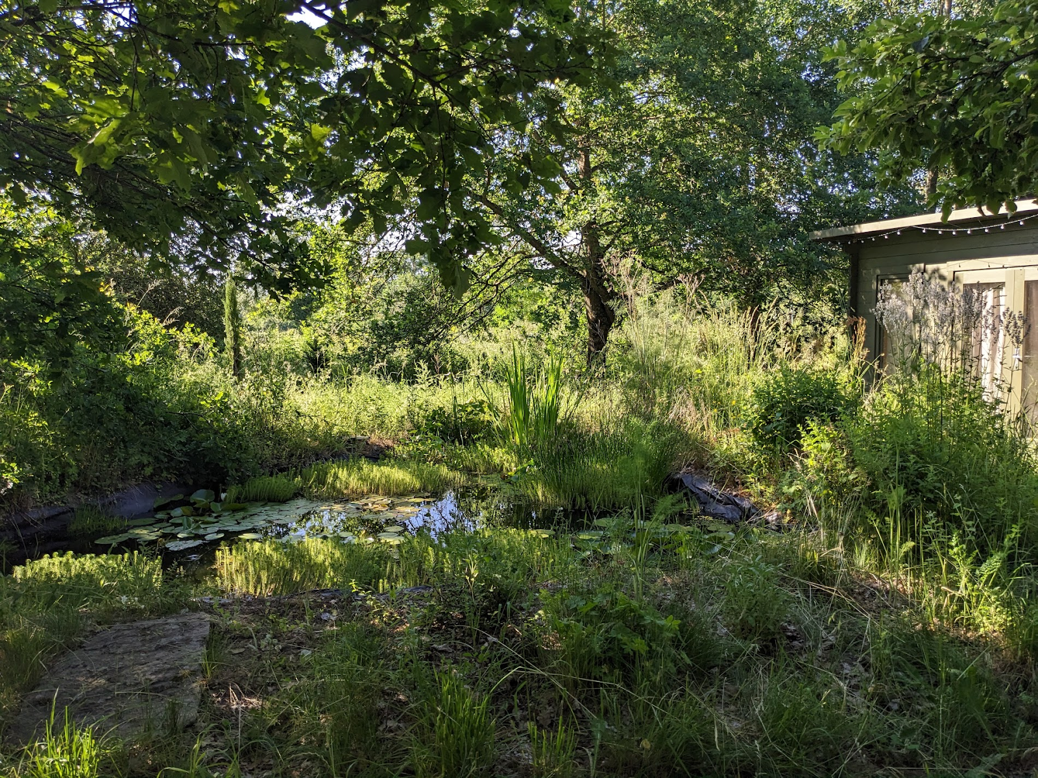
Escape

Slide 9
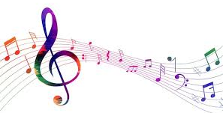
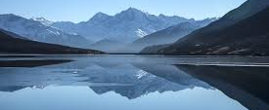
Listening
Listening to music, both distracts and calms mind and body.
Choose something which is calming with a slower beat (not sad words).
Relax, while listening. Let your gaze go soft or close your eyes.
Focus on the rhythm.
Do a quick body scan to check there is no site of tension (shoulders, jaw, hands are often the sites of tension)

Slide 10
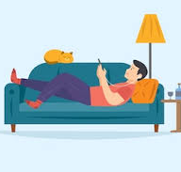
Choice of Music ?
I once read that the Adagio from Spartacus is supposed to be very calming for a rapid pulse.
https://www.youtube.com/watch?v=iGlQQ0sFFW4
Arvo Pärt- Spiegel im Spiegel – is more modern.
https://www.youtube.com/watch?v=TJ6Mzvh3XCc
Music is very individual - someone I know always chooses Albatross by Fleetwood Mac, and it has a strong rhythmic pulsing beat, if you listen to the bass.
https://www.youtube.com/watch?v=fXeKi6ZkbOw

Slide 11
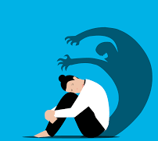
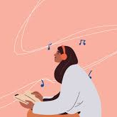
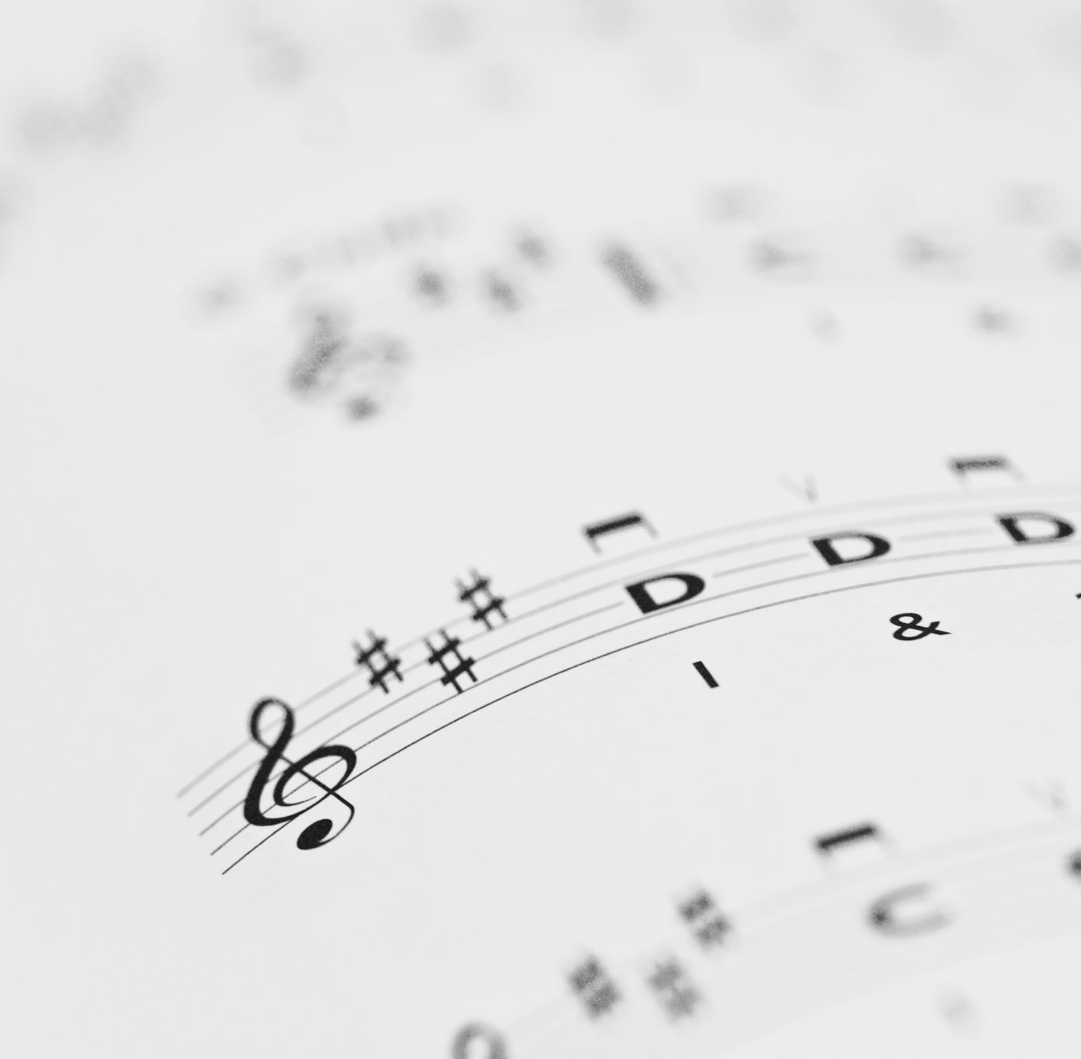
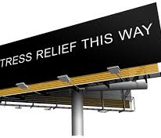
Soundscape & Playlists
Classical
Smooth
A montage of melodies
Un ’mélange’ of melodies!

Slide 12
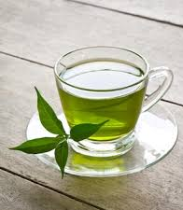
Taste – A brew
My ‘go to’ is a cup of tea. (I’m English). Fragrant green or floral chamomile. I hold the cup, smell the fragrance, feel the warmth of the cup.
For others, a cold drink works.
It doesn’t matter – sipping from a water bottle or paper cup is fine at these times.
When we are very stressed our digestive system slows down, so a drink is suggested, rather than eating.
Chewing gum is good, for those who like it, as it relaxes the jaw – gum tends to be a love/hate thing.

Slide 13
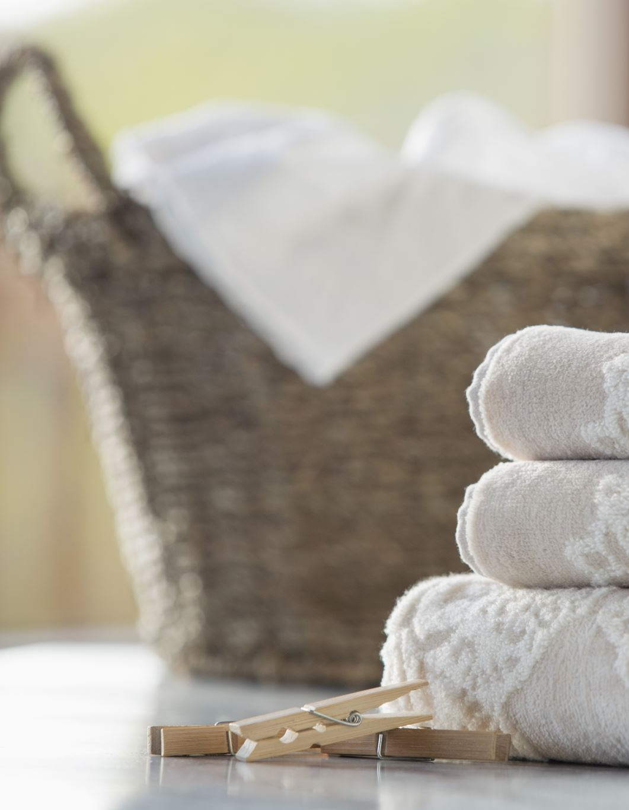
Sense of touch
Cool/cold water on your hands
If you can then hand cream massaged into your hands
Hold something soft and comforting e.g. a scarf corner
If you are at home, wrap yourself in something like a blanket or duvet with warmth and gentle pressure on your skin.
Close your eyes and imagine being hugged.

Slide 14
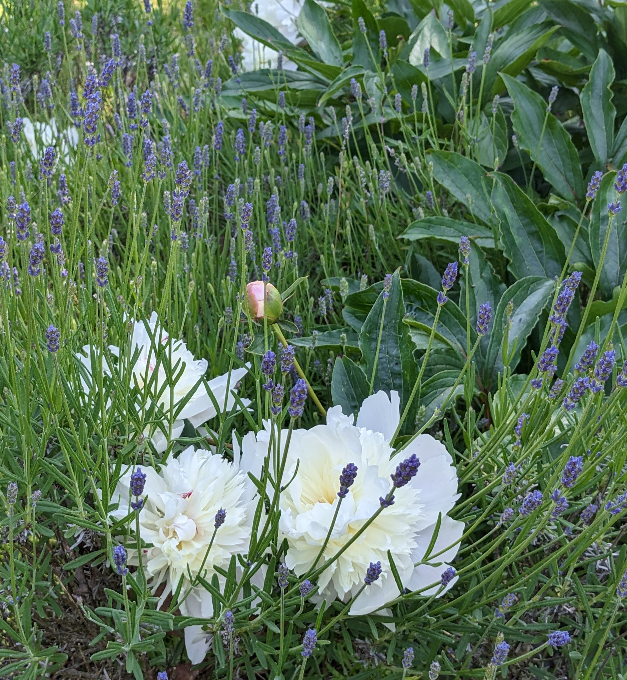
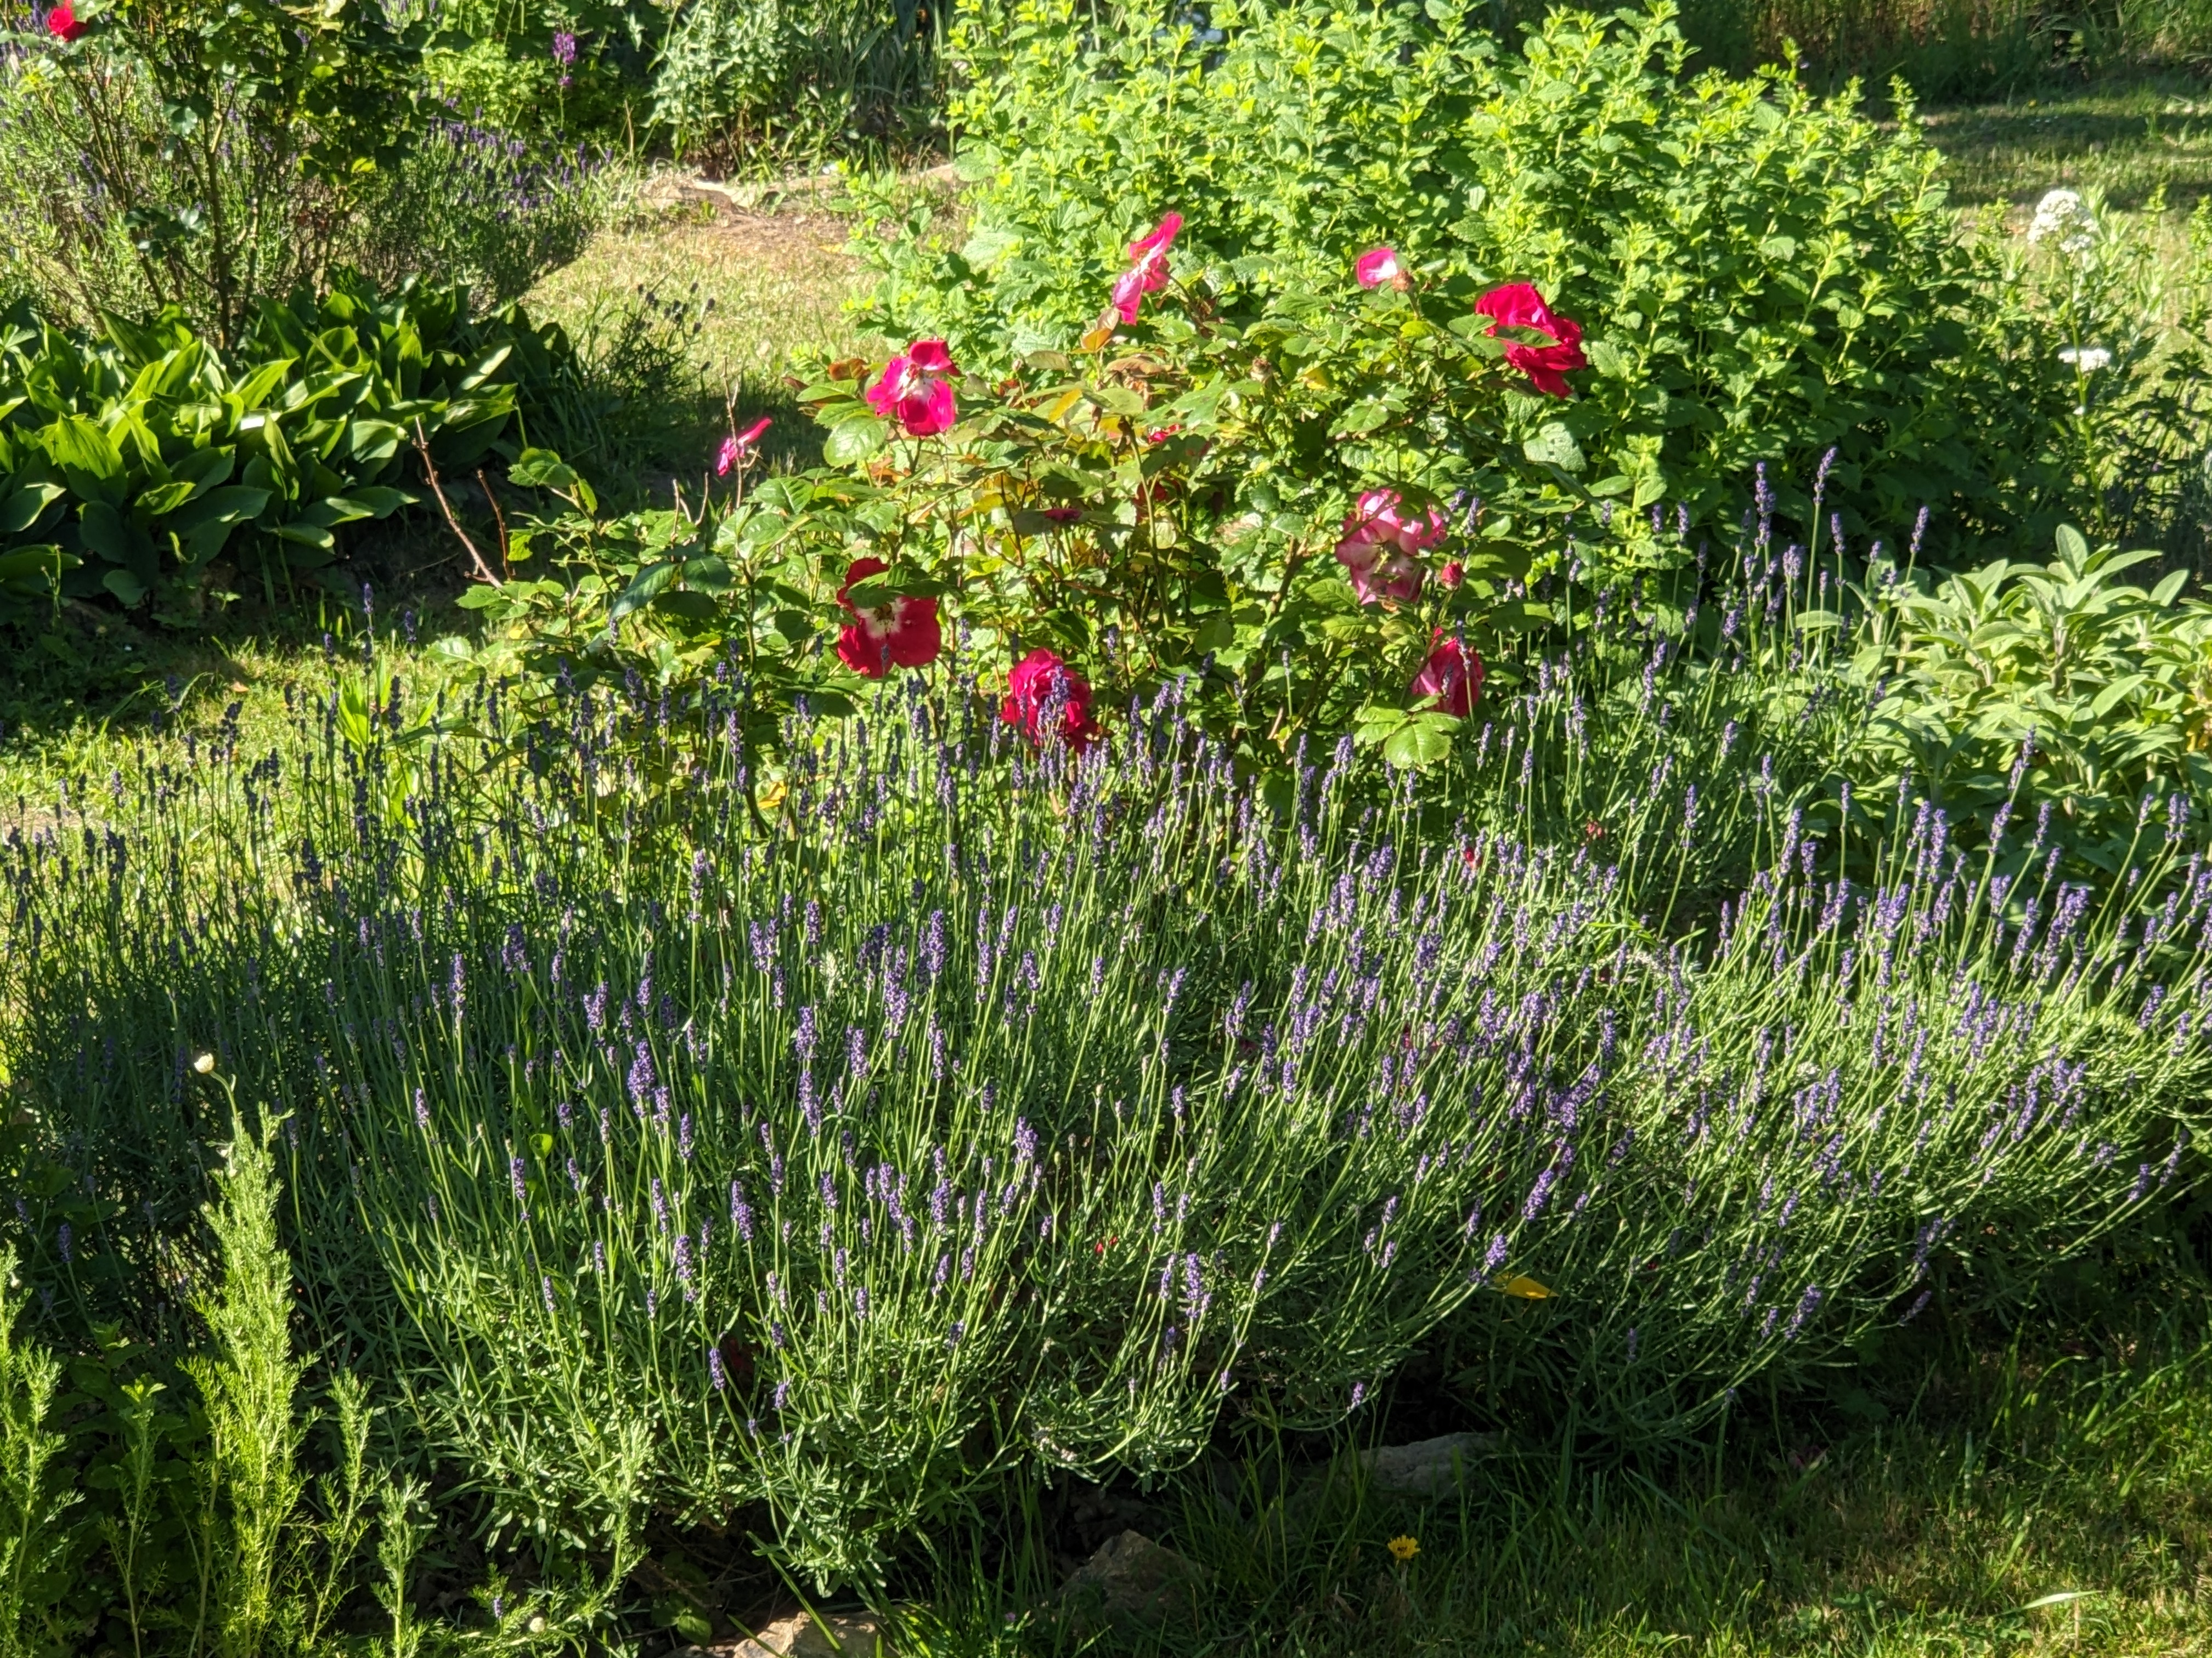
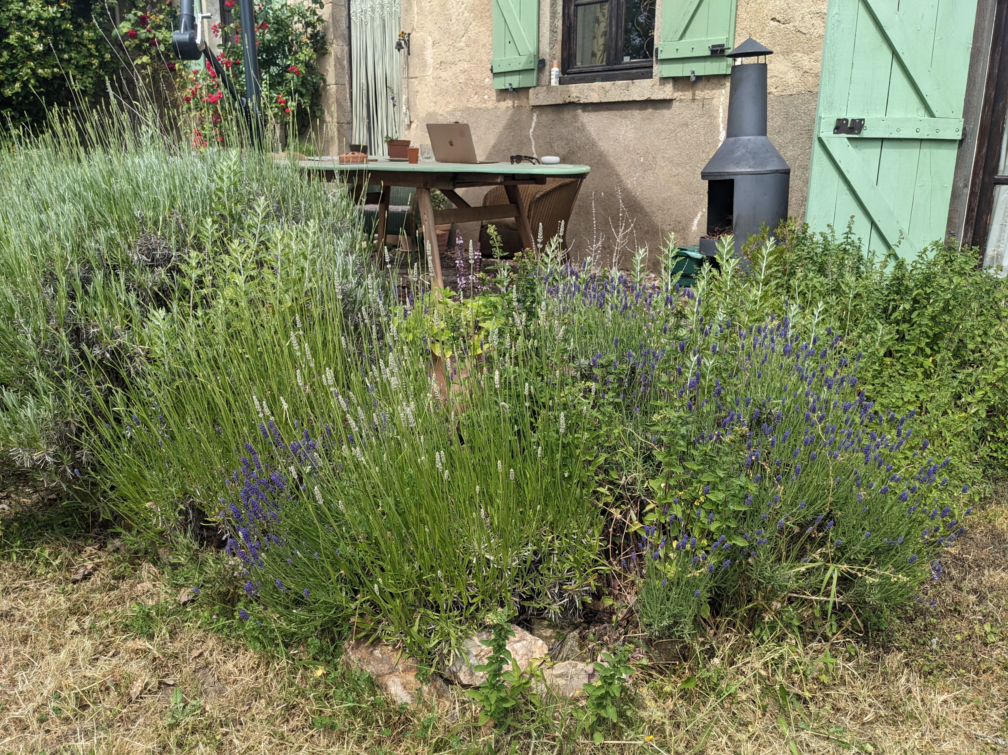
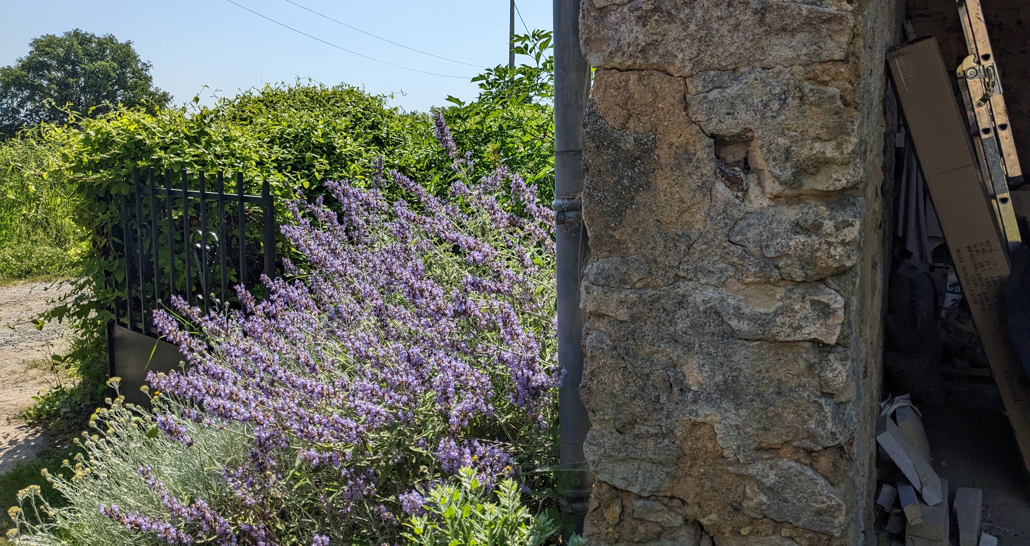
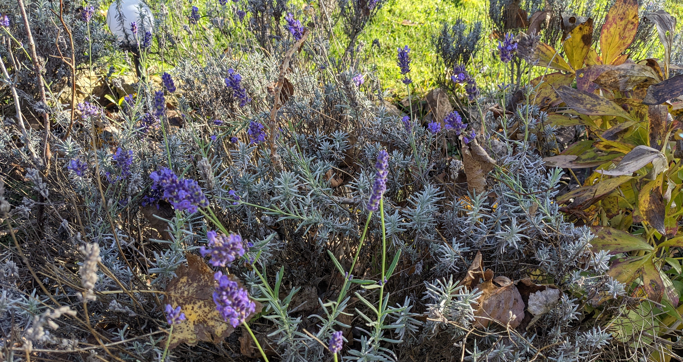
Touch, Taste & Vision

Slide 15
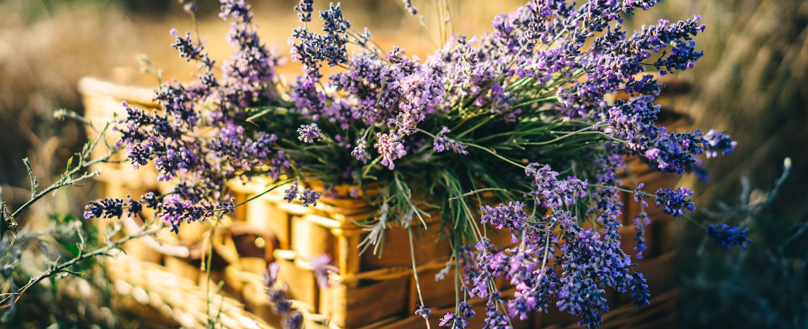
Sense of Smell
Smell oil of lavender, clary sage or rose.
Or a sprig of fresh herbs.
Breathe in the scent. Focus on the scent.
When I had a stressful job, I used to have a tiny bottle of clary sage in my bag.
A few drops on a tissue works well too

Slide 16
I have a tissue (Kleenex) with drops of lavender or geranium oil ready on a flight.
Again, this is individual … the scent of coconut oil or special perfume … drift away to a beach or a summer’s day.
I have a very old fashioned lavender perfume which my grandmother liked, which is calming.

Slide 17
Now for any Questions….

Slide 18
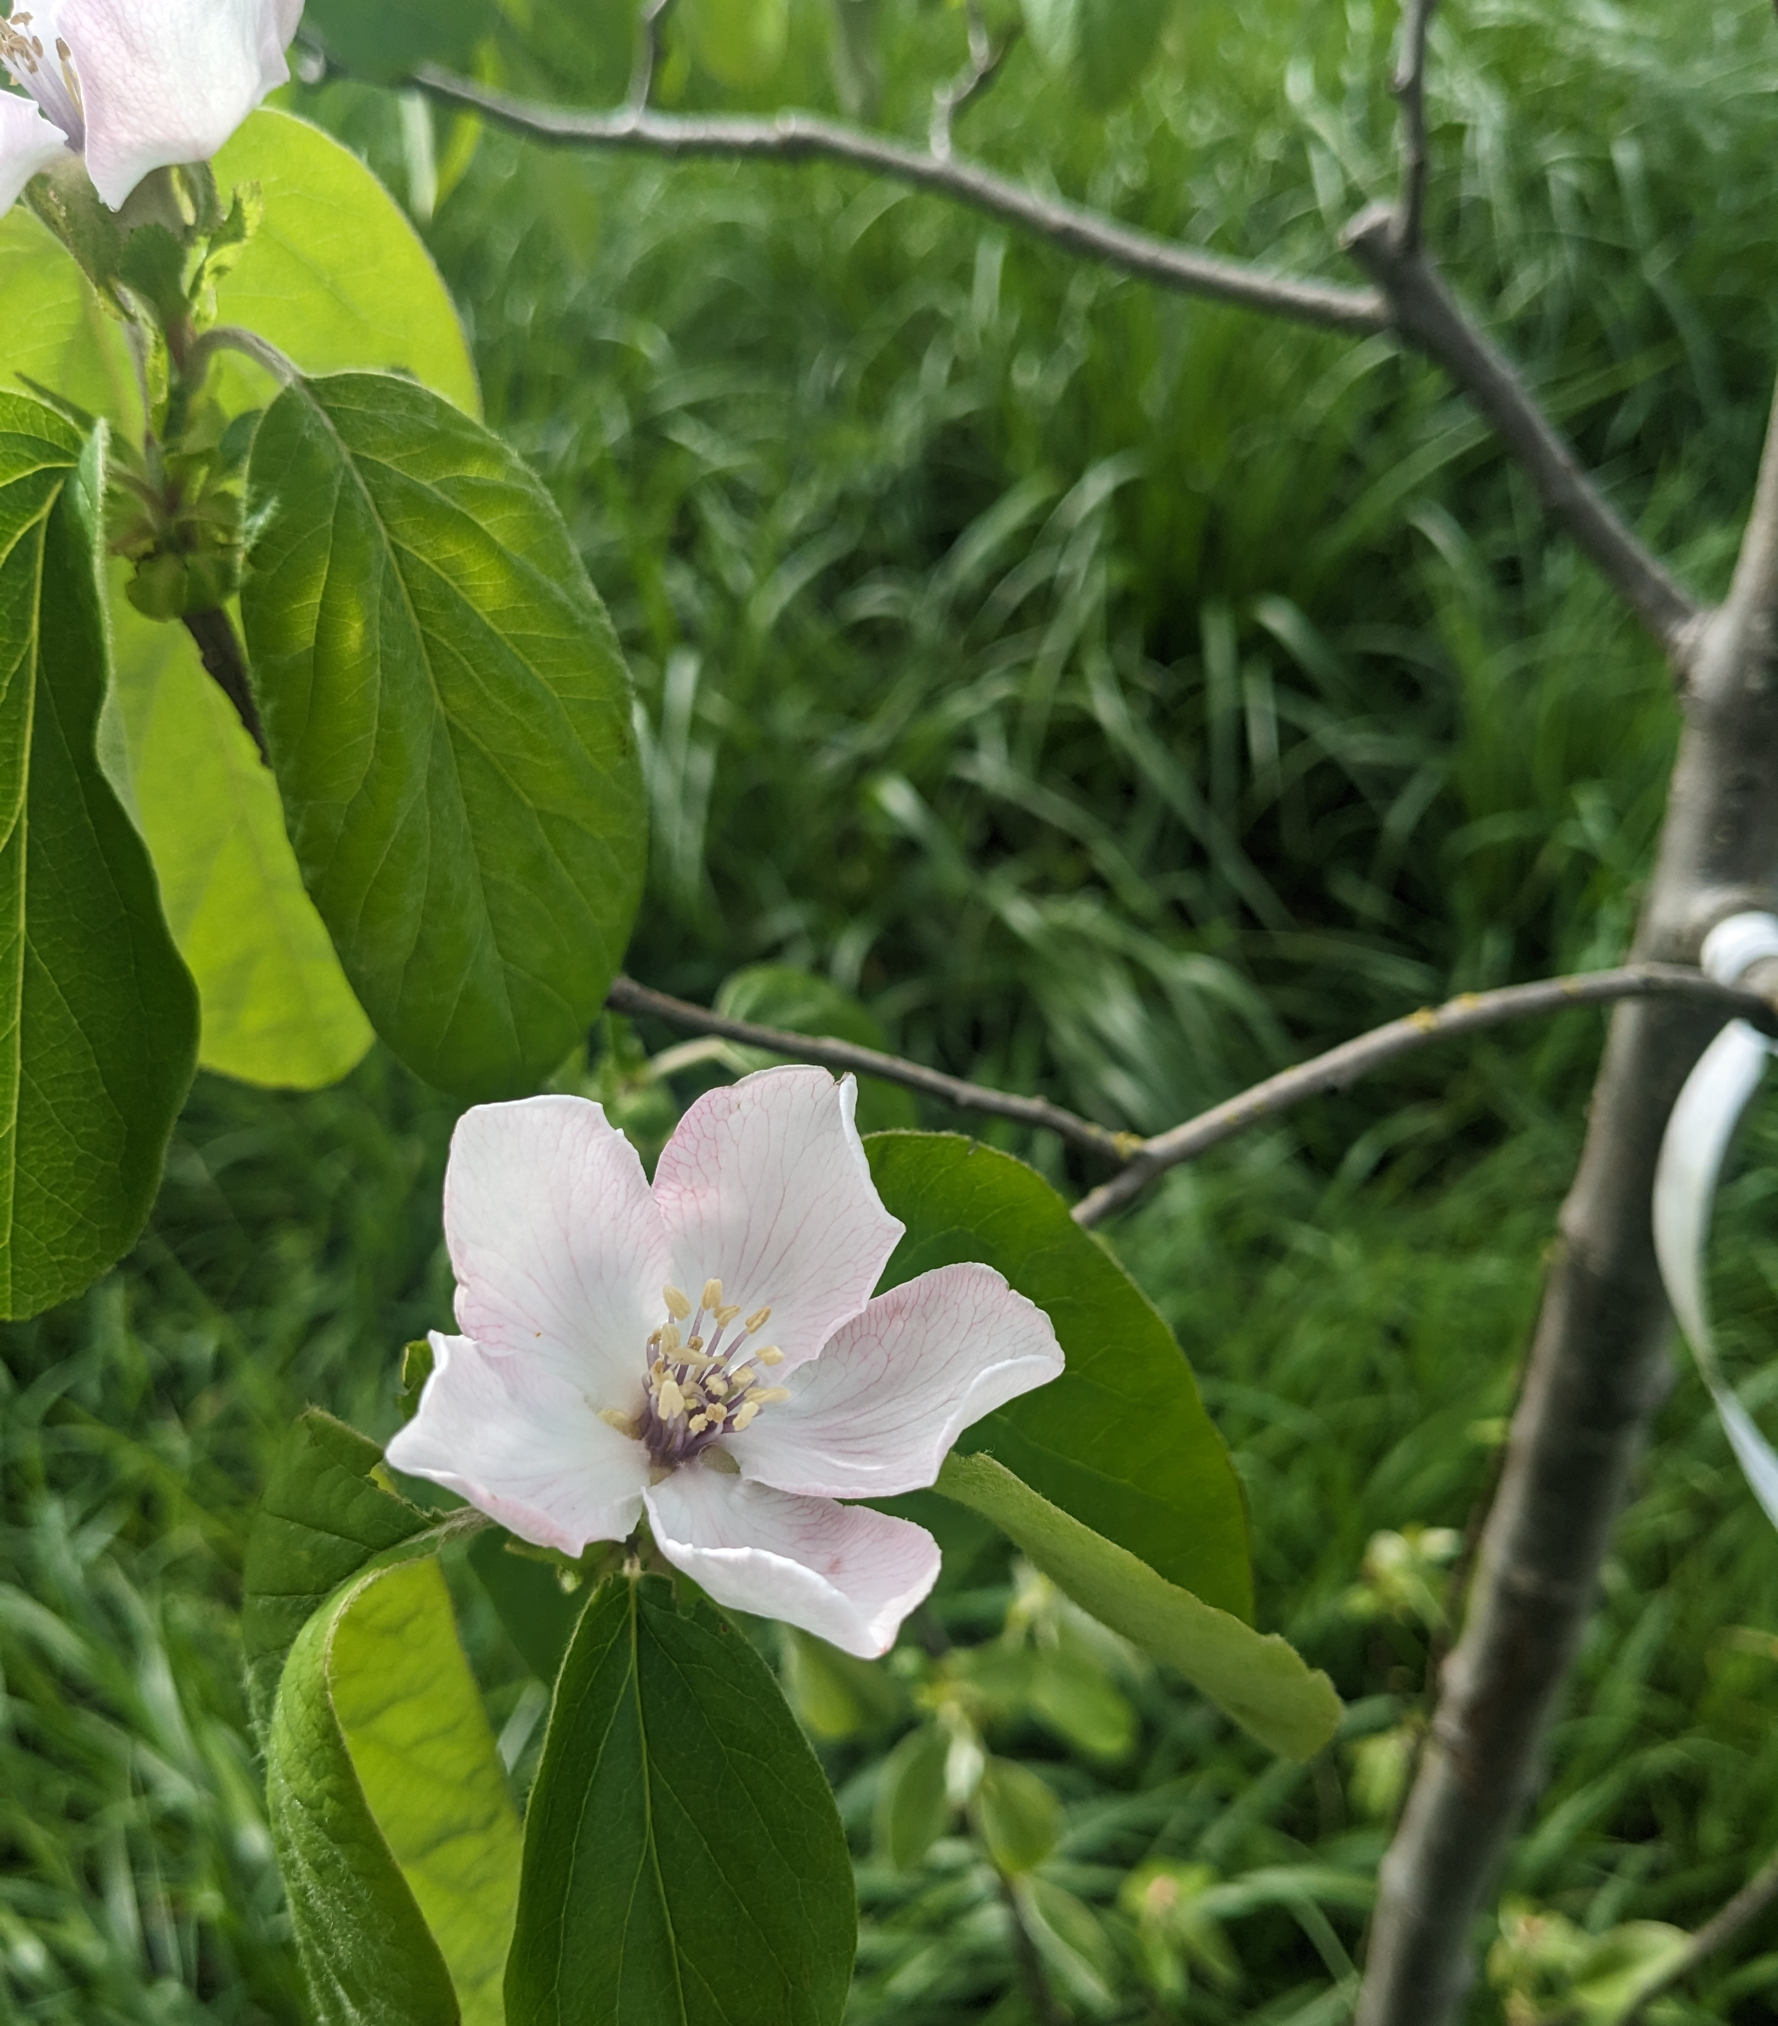
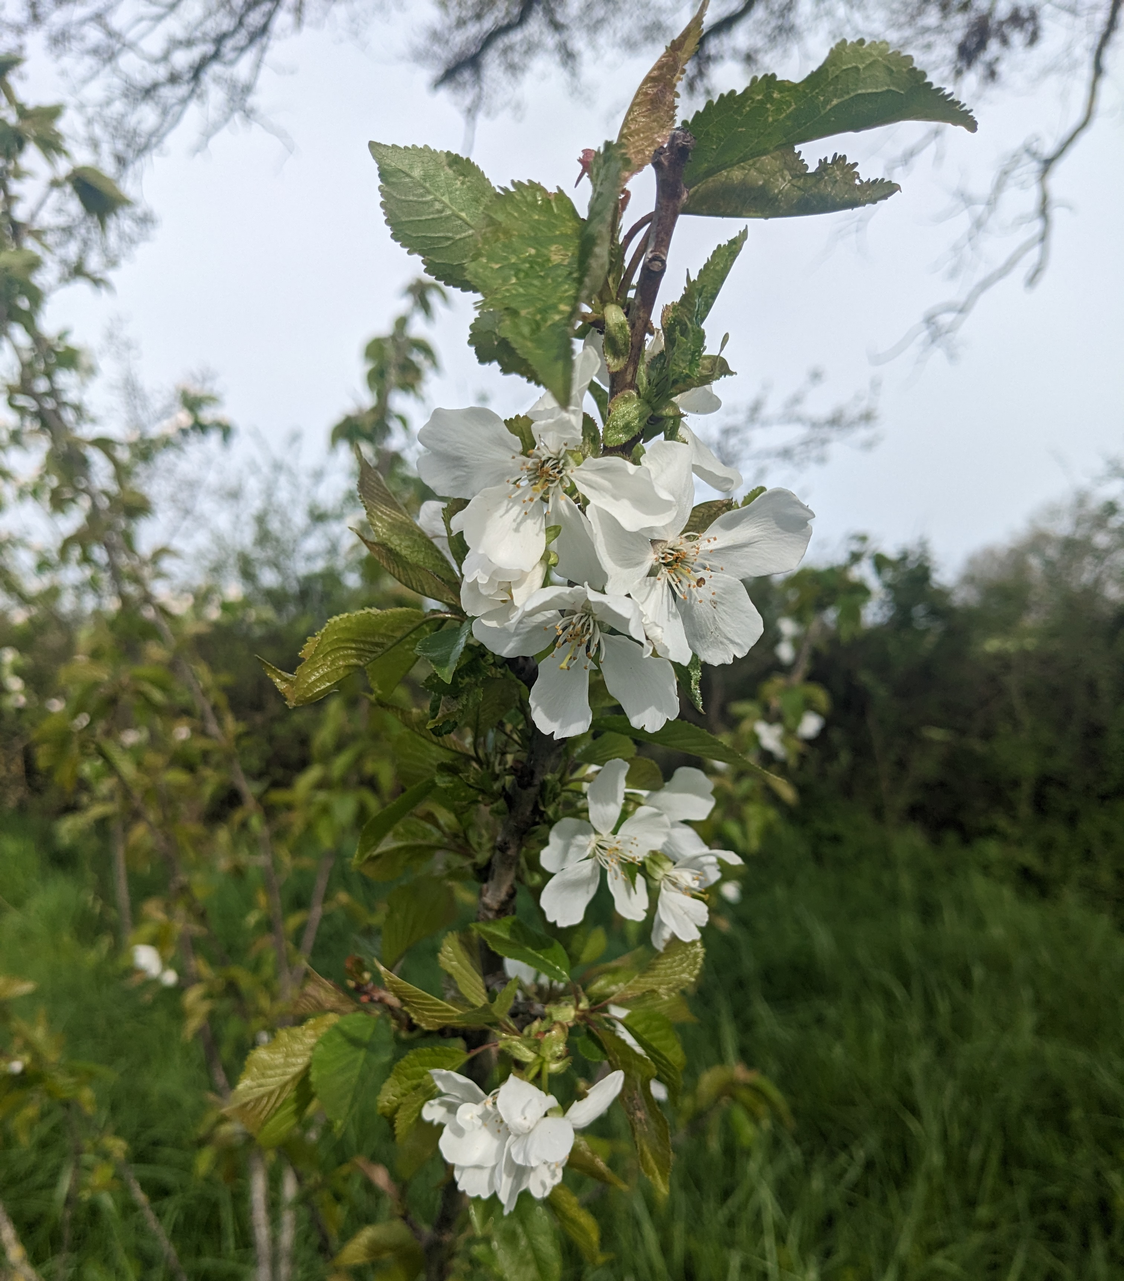
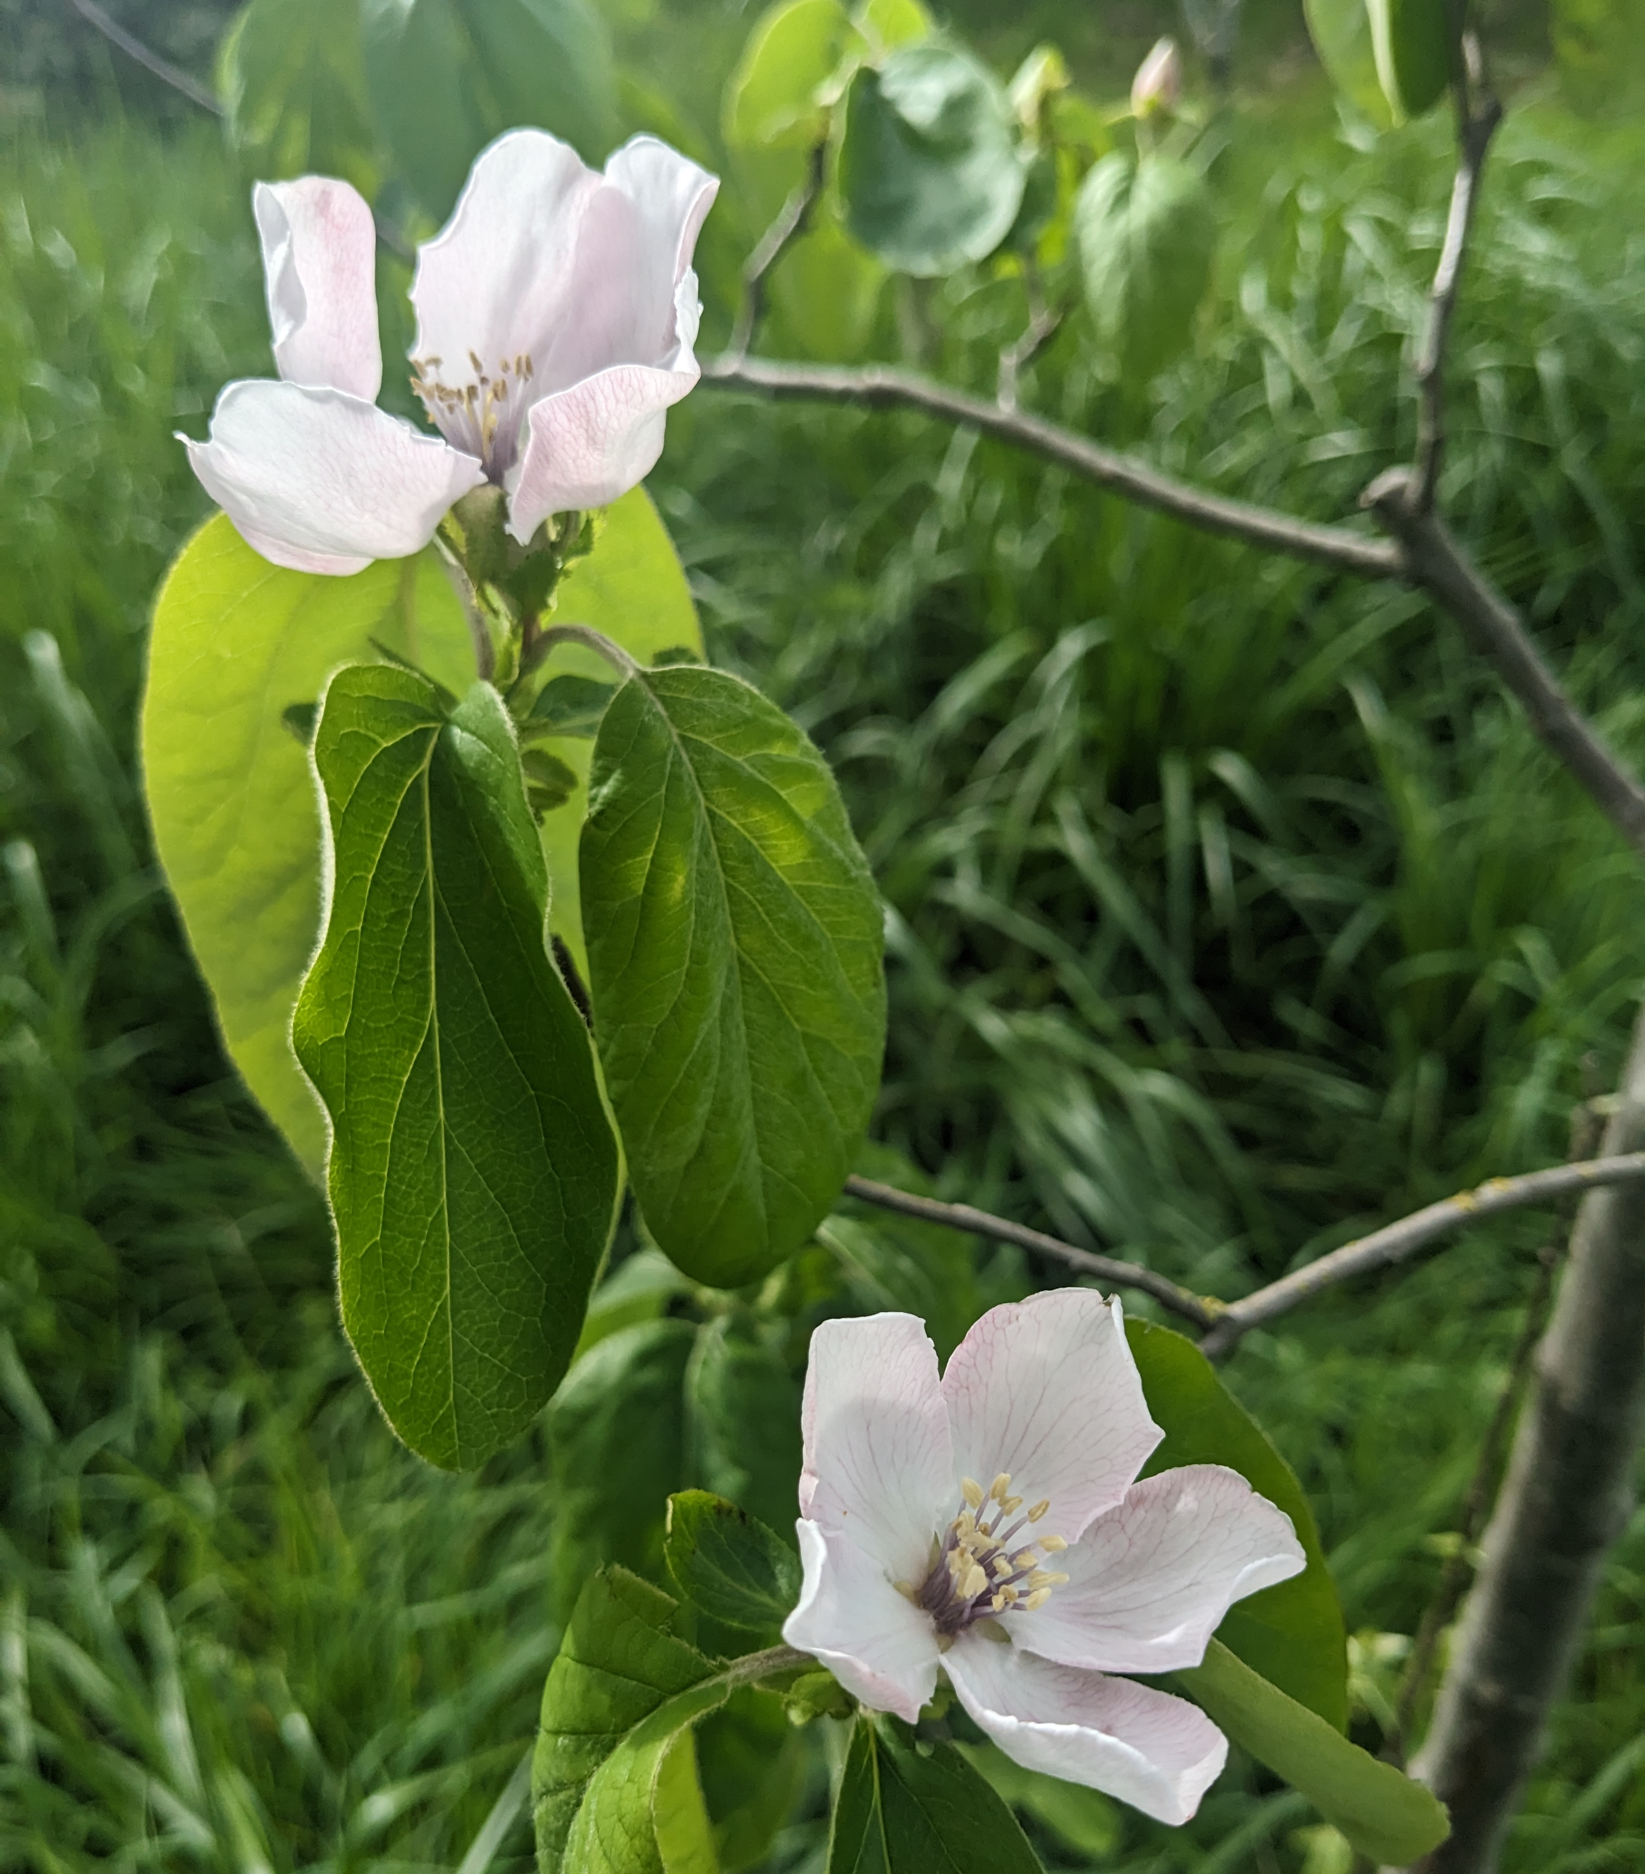
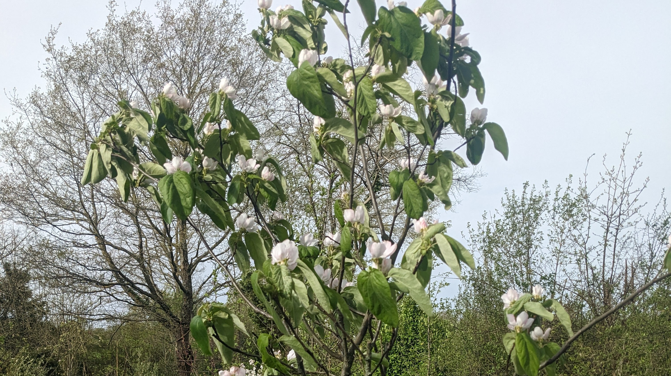
Au revoir … à la prochaine

